Slide 1
BUILDOTS UPDATE : 05/01/2020

Slide 2
SUMMARY
5 experiments : 10 FPS, 5 camera models, CLOSE, 1000px
5 experiments : 20 FPS, 5 camera models, CLOSE, 1000px
1 experiment using buildots extraction and calibration scripts, CLOSE

Slide 3
EXPERIMENTS INDEX
10 FPS
1 10FPS SIMPLE_RADIAL_FISHEYE
2 10FPS SIMPLE_RADIAL
3 10FPS RADIAL
4 10FPS SIMPLE_PINHOLE 5 10FPS PINHOLE
20 FPS
6 20FPS SIMPLE_RADIAL_FISHEYE
7 20FPS SIMPLE_RADIAL
8 20FPS RADIAL
9 20FPS SIMPLE_PINHOLE 10 20FPS PINHOLE
11 JONATHAN EXPERIMENT

Slide 4
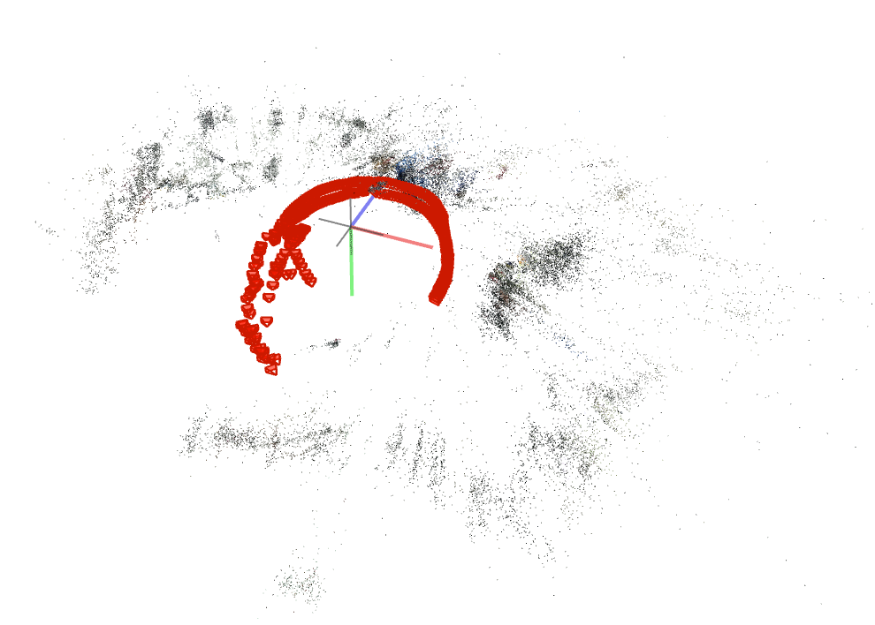
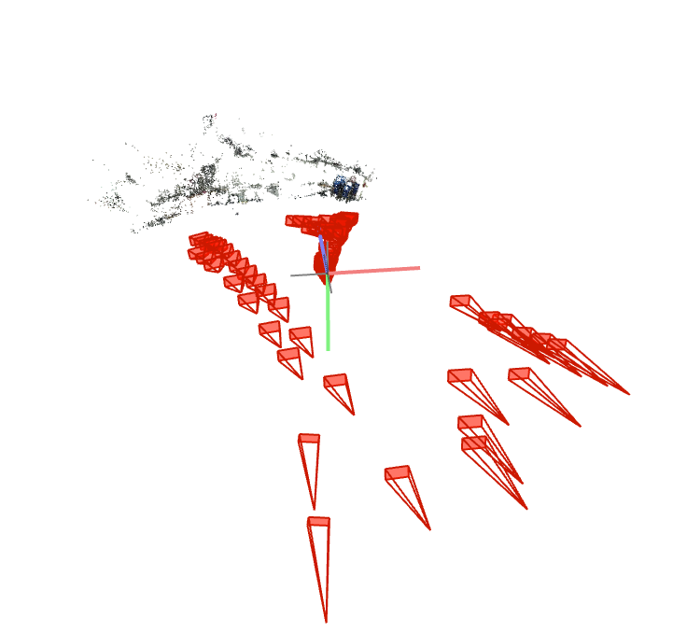
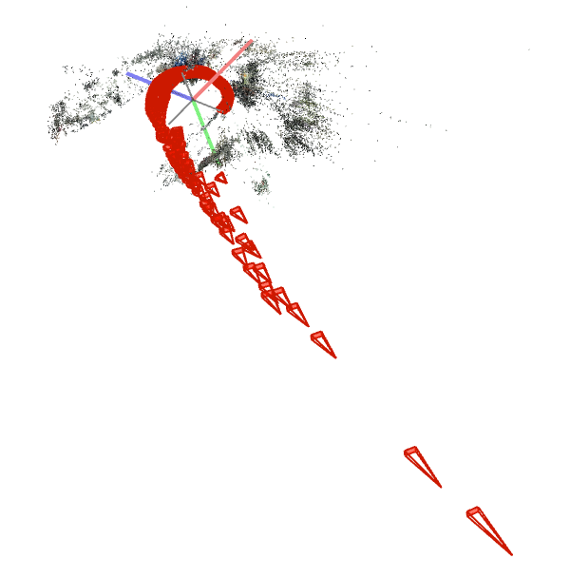
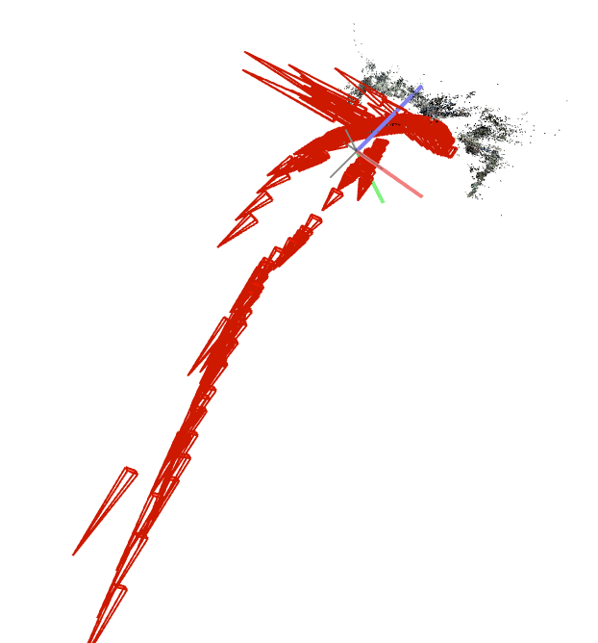
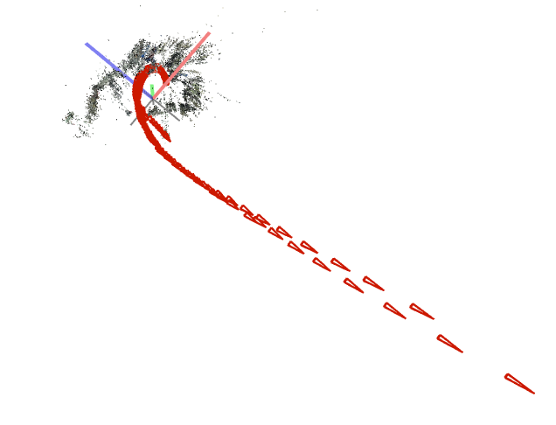
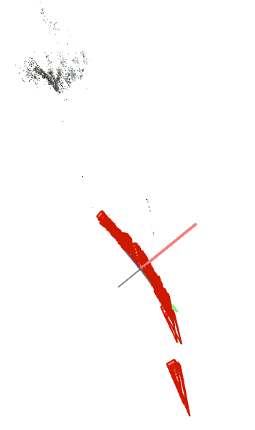
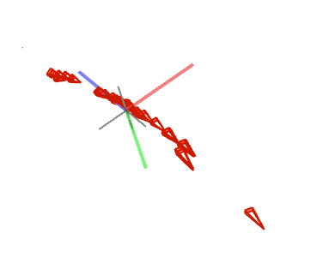
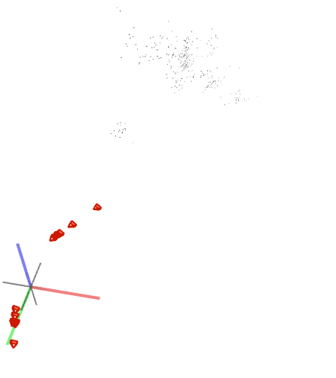
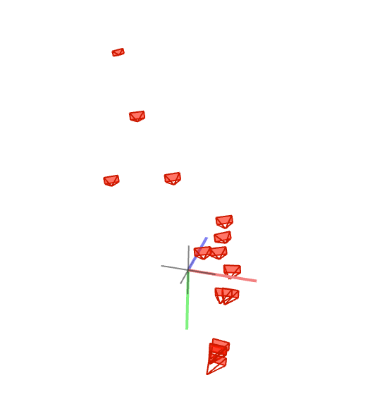
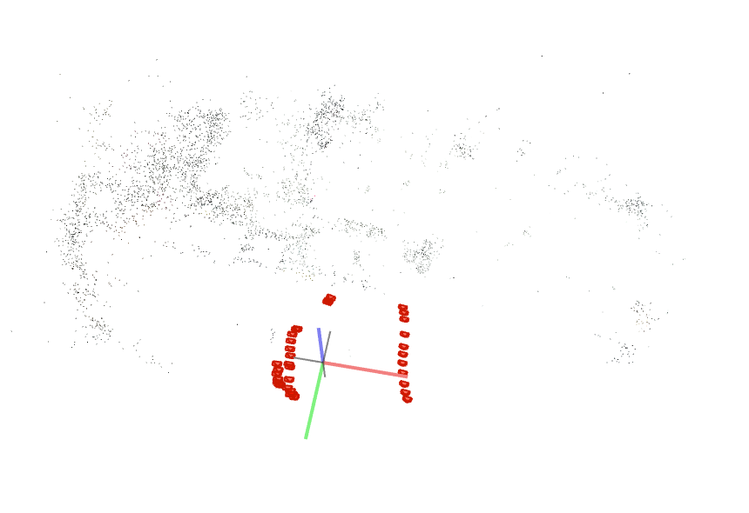
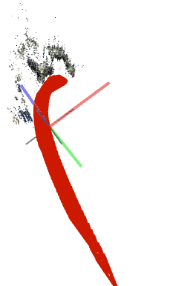
PREVIEW :10 FPS
SIMPLE_RADIAL_FISHEYE 1 Sparse model | SIMPLE_RADIAL 2 Sparse models | RADIAL 3 Sparse models | SIMPLE_PINHOLE 7 Sparse models | PINHOLE 6 Sparse models

Slide 5
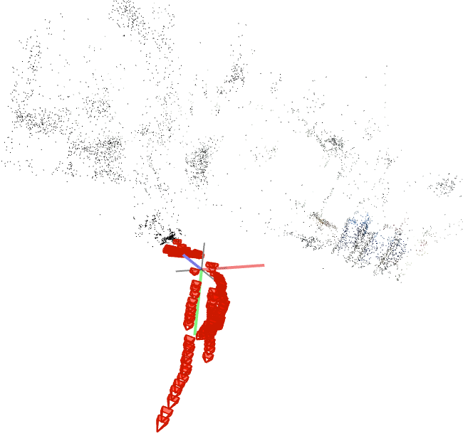
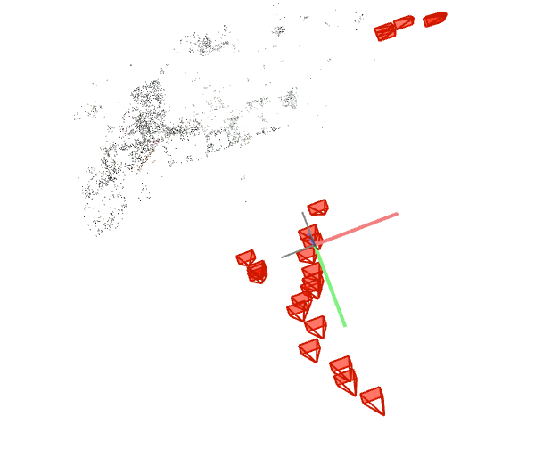
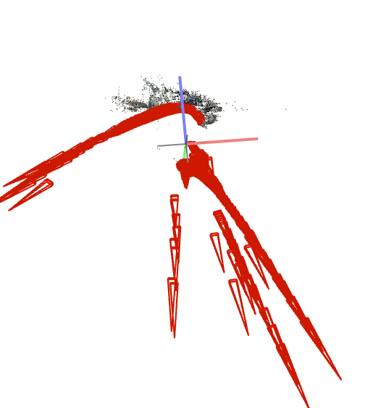
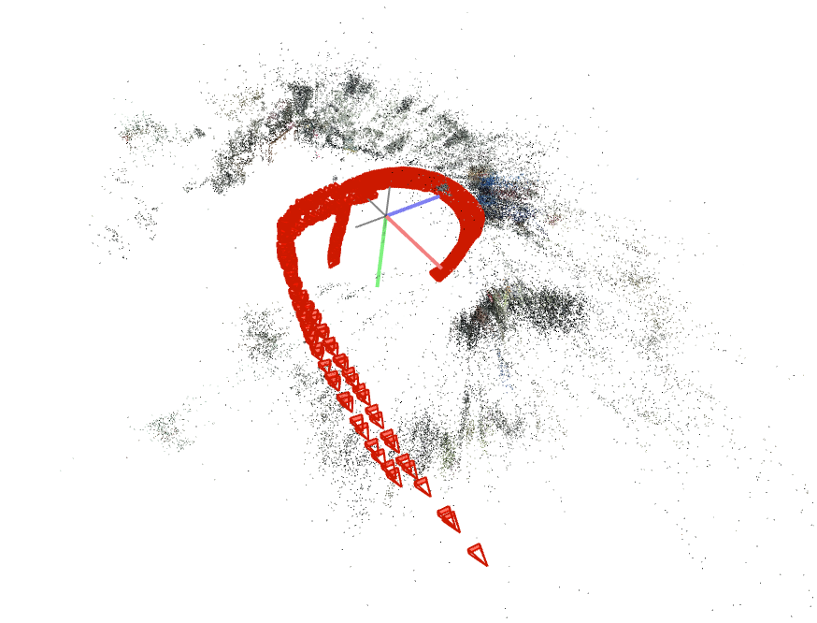
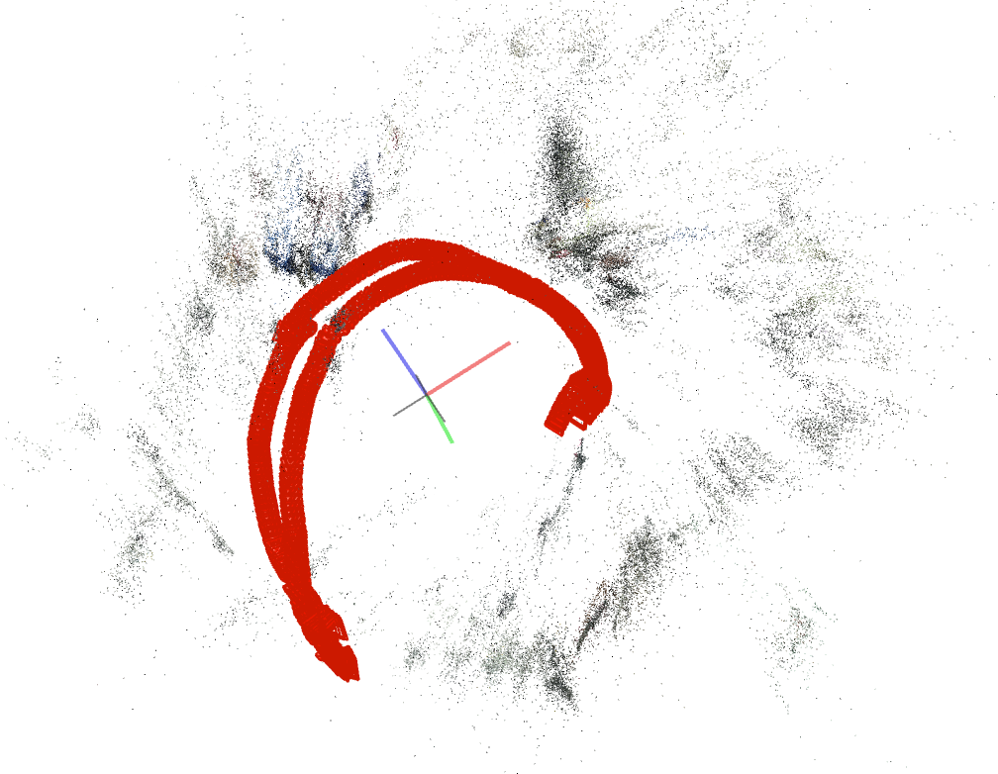
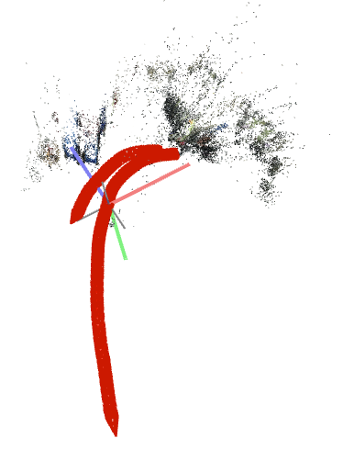
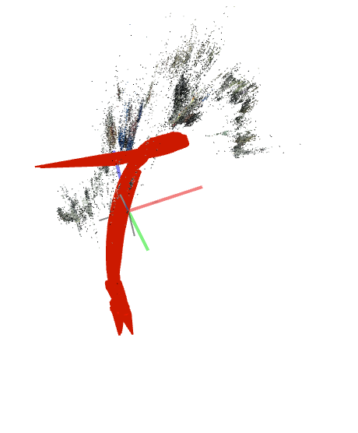
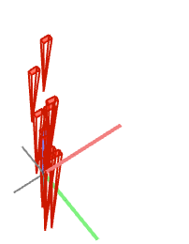
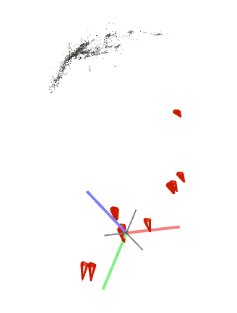
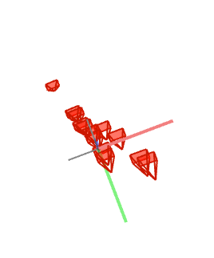
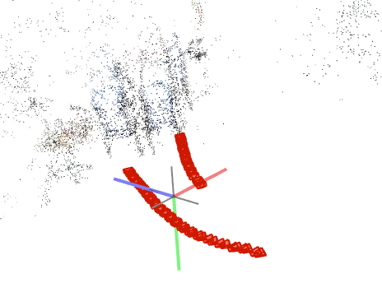
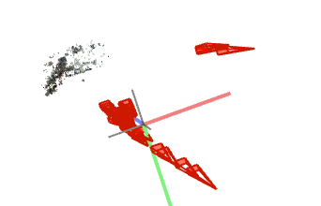
PREVIEW : 20 FPS
SIMPLE_RADIAL_FISHEYE 1 Sparse model | SIMPLE_RADIAL 10 Sparse models | RADIAL 1 Sparse model | SIMPLE_PINHOLE 7 Sparse models | PINHOLE 4 Sparse models

Slide 6
CONCLUSION

Slide 7
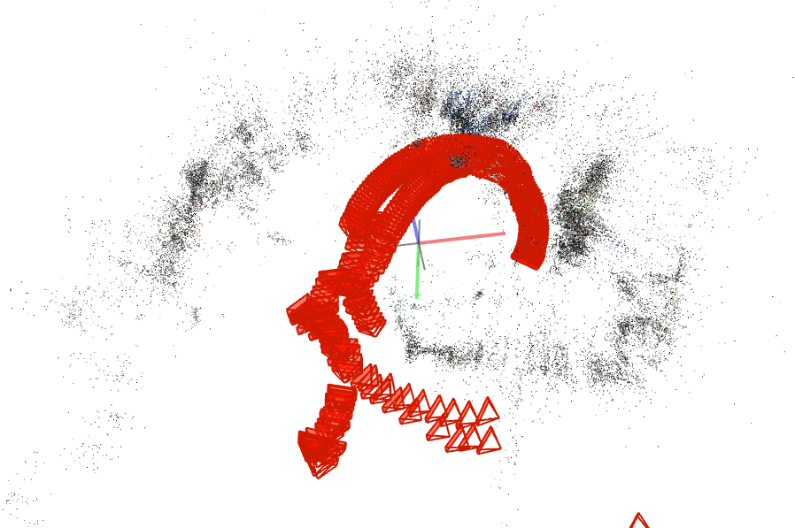
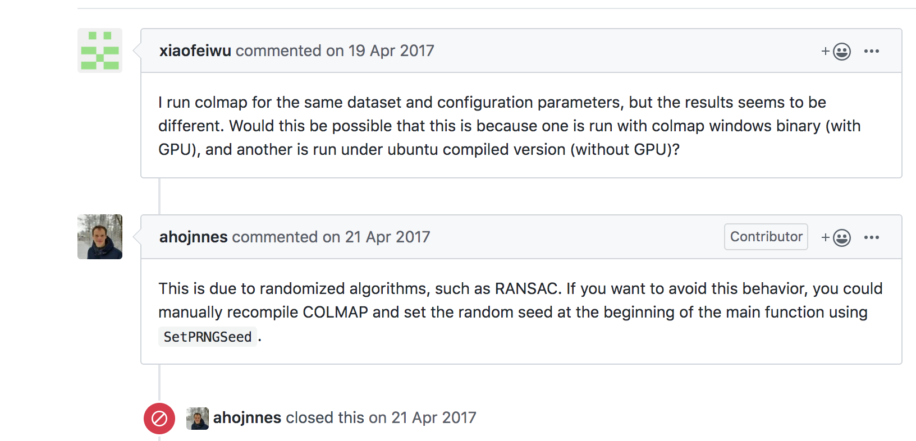
Experiment 1
FPS : 10
# Frames : 356
Record length : 36 [s]
Camera distance model : CLOSE
Frame size : 1000
Camera model : SIMPLE_RADIAL_FISHEYE
Sparse models : 1
Notes: Colmap seems to give different results for same dataset and parameters. This issue was brought to Colmap repo (issue #109).
Previously:

Slide 8
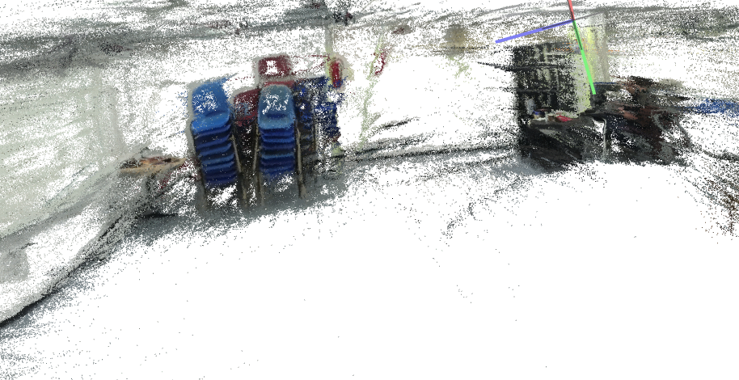
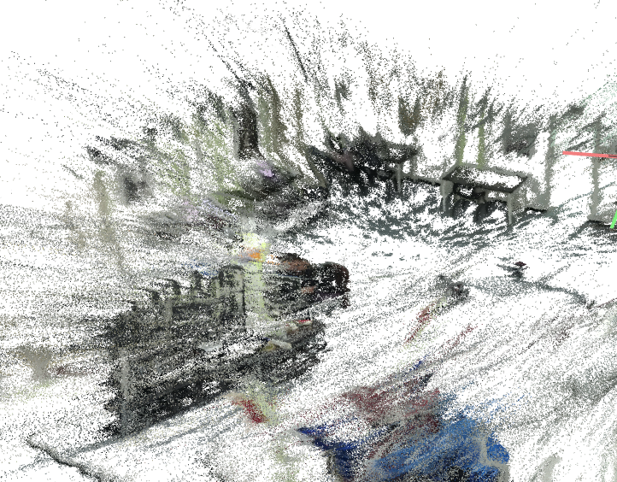
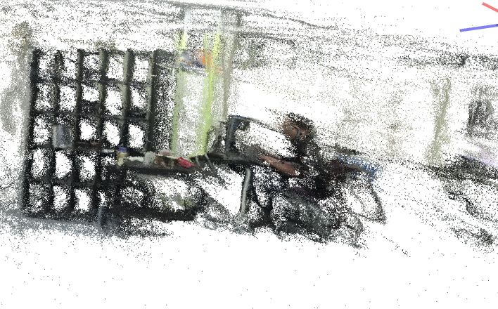
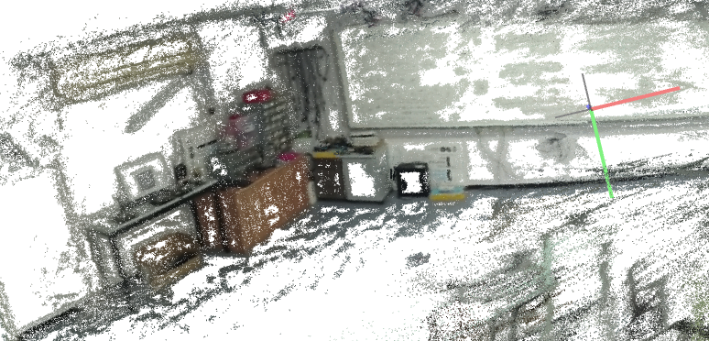
DENSE RECONSTRUCTION
FPS : 10
# Frames : 356
# Frames used : 329
Record length : 36 [s]
Camera distance model : CLOSE
Frame size : 1000
Camera model : SIMPLE_RADIAL_FISHEYE

Slide 9
Experiment 2
FPS : 10
# Frames : 356
Record length : 36 [s]
Camera distance model : CLOSE
Frame size : 1000
Camera model : SIMPLE_RADIAL
Sparse model : 2

Slide 10
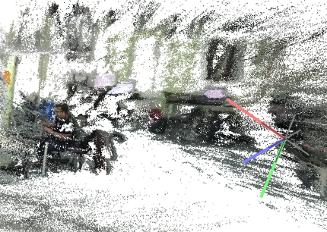
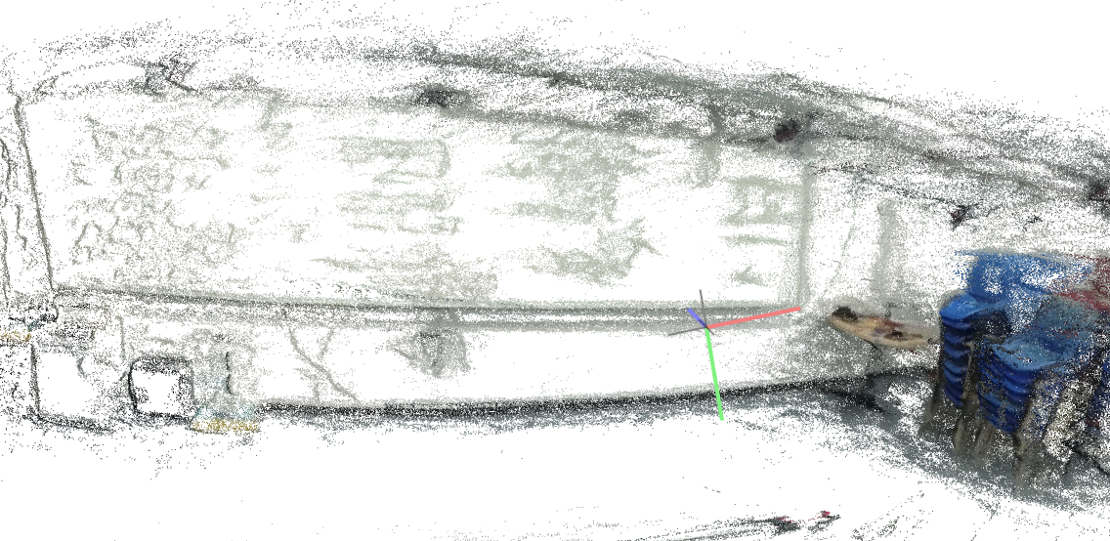
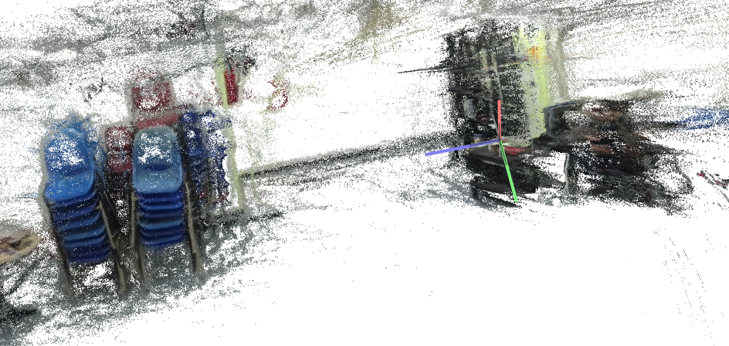
DENSE RECONSTRUCTION
FPS : 10
# Frames : 356
# Frames used : 338
Record length : 36 [s]
Camera distance model : CLOSE
Frame size : 1000
Camera model : SIMPLE_RADIAL

Slide 11
Experiment 3
FPS : 10
# Frames : 356
Record length : 36 [s]
Camera distance model : CLOSE
Frame size : 1000
Camera model : RADIAL
Sparse models : 3

Slide 12
DENSE RECONSTRUCTION
FPS : 10
# Frames : 356
# Frames used :
Record length : 36 [s]
Camera distance model : CLOSE
Frame size : 1000
Camera model : RADIAL

Slide 13
Experiment 4
FPS : 10
# Frames : 356
Record length : 36 [s]
Camera distance model : CLOSE
Frame size : 1000
Camera model : SIMPLE_PINHOLE
Sparse models : 7

Slide 14
DENSE RECONSTRUCTION
FPS : 10
# Frames : 356
# Frames used :
Record length : 36 [s]
Camera distance model : CLOSE
Frame size : 1000
Camera model : SIMPLE_PINHOLE

Slide 15
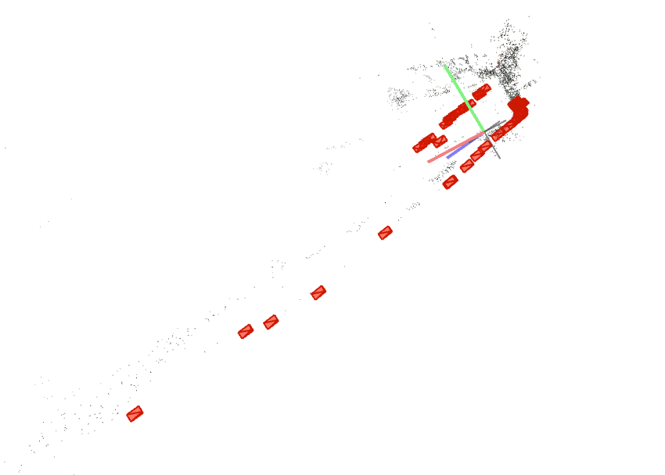
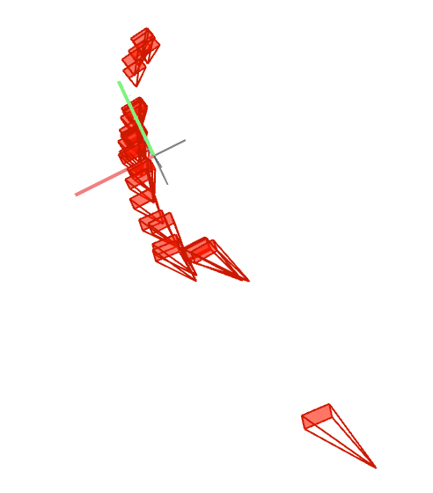
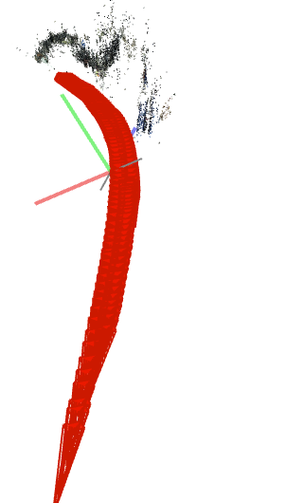
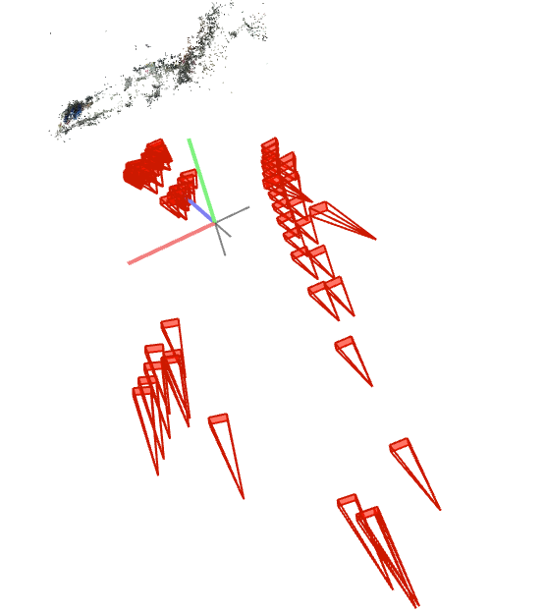
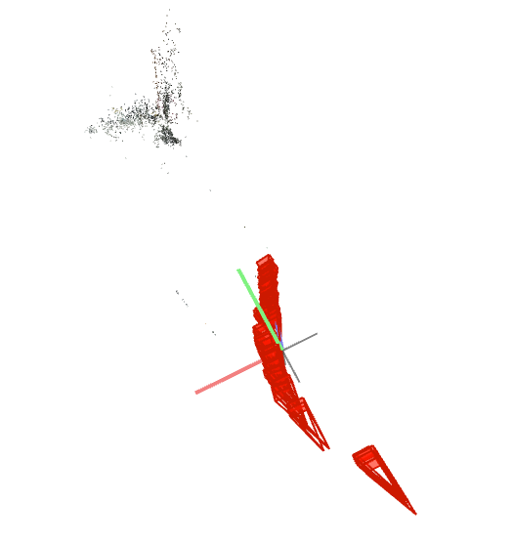
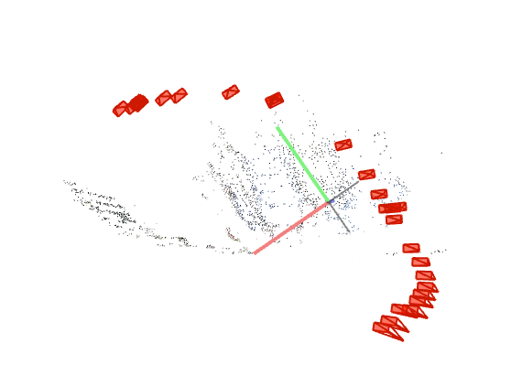
Experiment 5
FPS : 10
# Frames : 356
Record length : 36 [s]
Camera distance model : CLOSE
Frame size : 1000
Camera model : PINHOLE
Sparse models : 6

Slide 16
DENSE RECONSTRUCTION
FPS : 10
# Frames : 356
# Frames used :
Record length : 36 [s]
Camera distance model : CLOSE
Frame size : 1000
Camera model : PINHOLE

Slide 17
Experiment 6
FPS : 20
# Frames : 712
Record length : 36 [s]
Camera distance model : CLOSE
Frame size : 1000
Camera model : SIMPLE_RADIAL_FISHEYE
Sparse models : 1

Slide 18
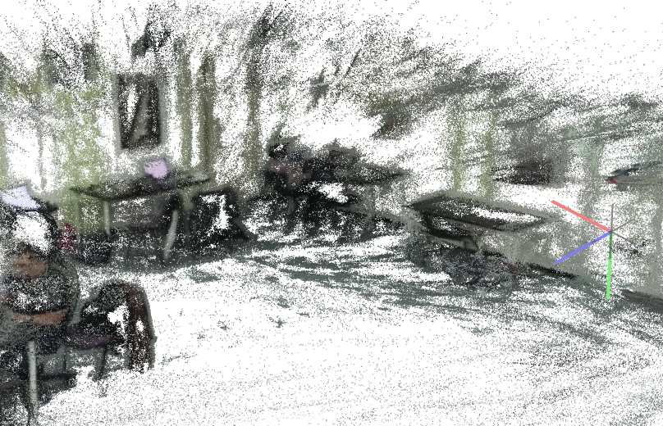
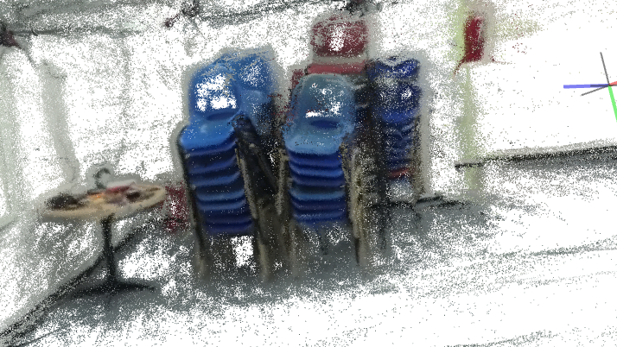
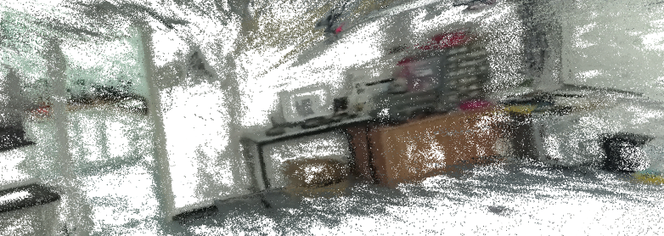
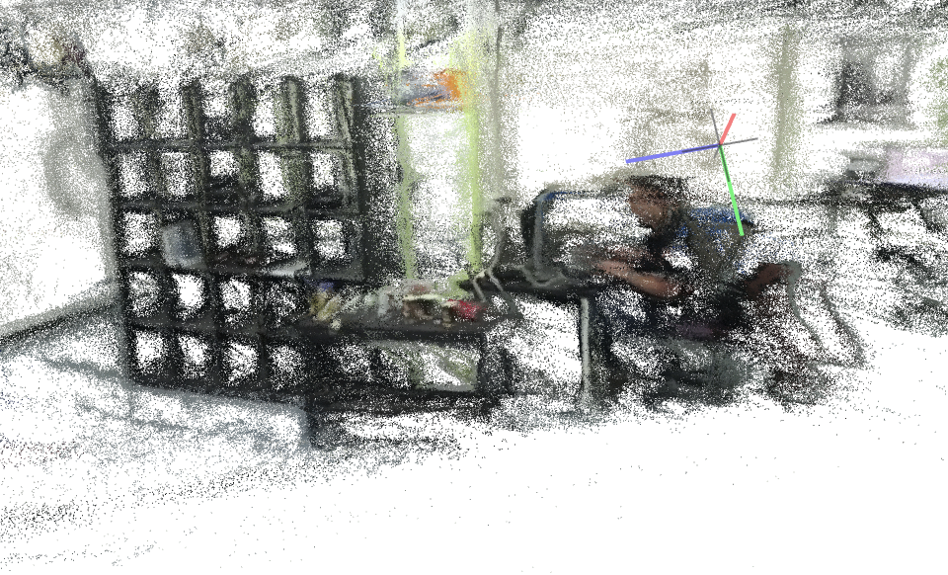
DENSE RECONSTRUCTION
FPS : 20
# Frames : 712
# Frames used : 712
Record length : 36 [s]
Camera distance model : CLOSE
Frame size : 1000
Camera model : SIMPLE_RADIAL_FISHEYE

Slide 19
Experiment 7
FPS : 20
# Frames : 712
Record length : 36 [s]
Camera distance model : CLOSE
Frame size : 1000
Camera model : SIMPLE_RADIAL
Sparse model : 3

Slide 20
DENSE RECONSTRUCTION
FPS : 20
# Frames : 712
# Frames used :
Record length : 36 [s]
Camera distance model : CLOSE
Frame size : 1000
Camera model : SIMPLE_RADIAL

Slide 21
Experiment 8
FPS : 20
# Frames : 712
Record length : 36 [s]
Camera distance model : CLOSE
Frame size : 1000
Camera model : RADIAL
Sparse models : 1

Slide 22
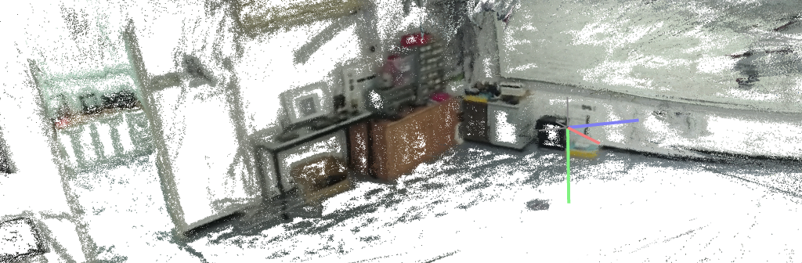
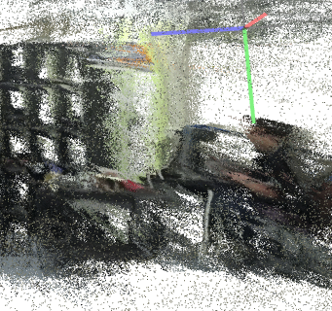
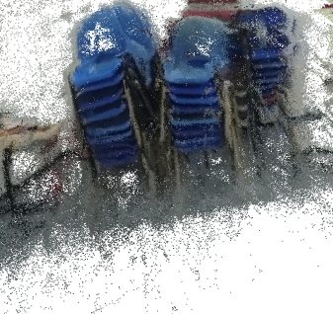
DENSE RECONSTRUCTION
FPS : 20
# Frames : 712
# Frames used : 655
Record length : 36 [s]
Camera distance model : CLOSE
Frame size : 1000
Camera model : RADIAL

Slide 23
Experiment 9
FPS : 20
# Frames : 712
Record length : 36 [s]
Camera distance model : CLOSE
Frame size : 1000
Camera model : SIMPLE_PINHOLE
Sparse models : 7

Slide 24
DENSE RECONSTRUCTION
FPS : 20
# Frames : 712
# Frames used :
Record length : 36 [s]
Camera distance model : CLOSE
Frame size : 1000
Camera model : SIMPLE_PINHOLE

Slide 25
Experiment 10
FPS : 20
# Frames : 712
Record length : 36 [s]
Camera distance model : CLOSE
Frame size : 1000
Camera model : PINHOLE
Sparse models : 4

Slide 26
DENSE RECONSTRUCTION
FPS : 20
# Frames : 712
# Frames used :
Record length : 36 [s]
Camera distance model : CLOSE
Frame size : 1000
Camera model : PINHOLE

Slide 27
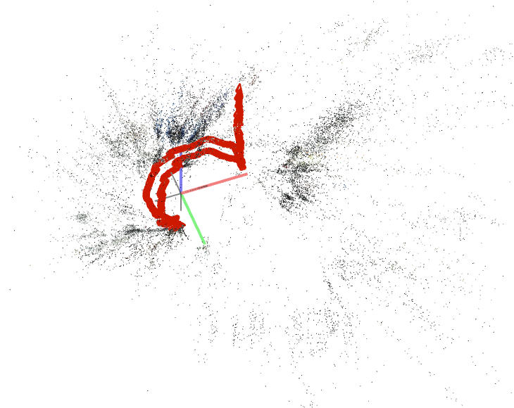
Experiment 11 Jonathan
FPS : 30
# Frames : 1067
Record length : 36 [s]
Camera distance model : CLOSE
Frame size : 1000x504px
Camera model : default (SIMPLE_RADIAL)
Sparse models : 1

Slide 28
DENSE RECONSTRUCTION
FPS :
# Frames :
# Frames used :
Record length : 36 [s]
Camera distance model : CLOSE
Frame size :
Camera model : default

